Slide 1
Wave initiation in neural columns
Vincent Baker
Drexel University Department of Physics

Slide 2
Plan
Have observed waves seem to start from common sites when stimulating entire column, want to understand why
Plan of attack:
Stimulate columns from bottom only, look for regions of column with consistently higher density (preferential firing regions)
If high-density regions found, stimulate entire column, see if waves start at those regions

Slide 3
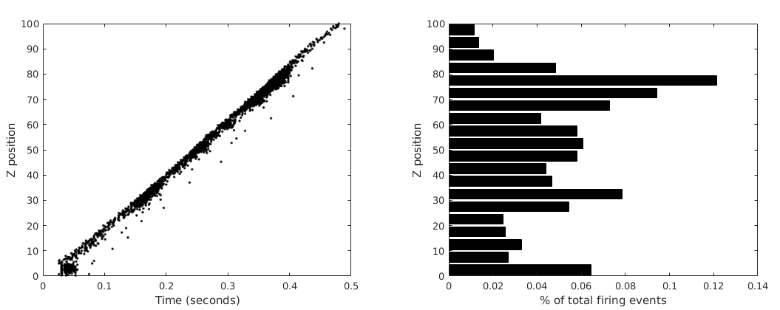
Impulse response of columns
Stimulate bottom 5 layers of a 100 layer column at t=10 ms
Consistent and repeatable single waves
Histogram of firing events to identify preferential firing regions

Slide 4
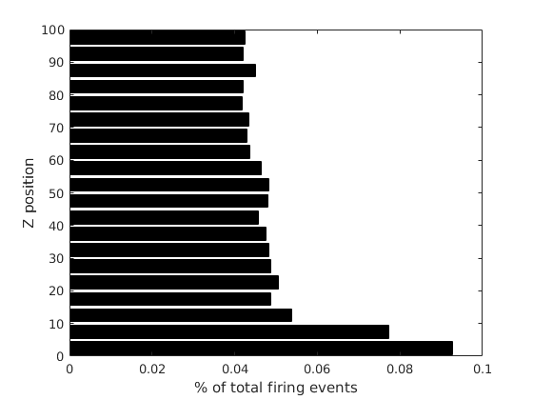
Average impulse response
Simulated 100 columns with impulse response, generated composite histogram (all firings from all columns). Each simulation had a new random draw on neuron parameters, connectivity and initial membrane potential
More firings near stimulation point, looks flat otherwise
No apparent preferential firing regions on average
Stimulated column layers 1-5

Slide 5
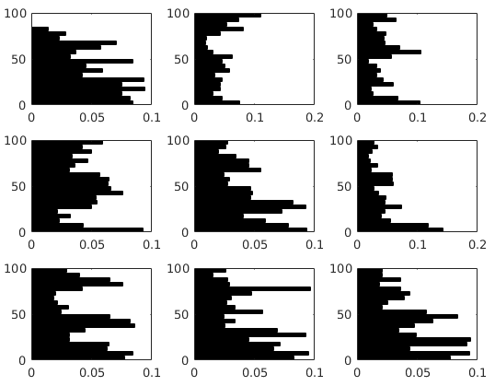
Density patterns in specific columns
Created 9 columns (neuron parameters and connectivity)
Ran 100 simulations of each column, random initial membrane potentials for each sim.
Composite histograms from all 100 runs show patterns in firing density for each column, no patterns across columns.
% of total firing events
Layer (Z position)
Any given column has preferential firing regions that appear to be related to connectivity and neuron parameters

Slide 6
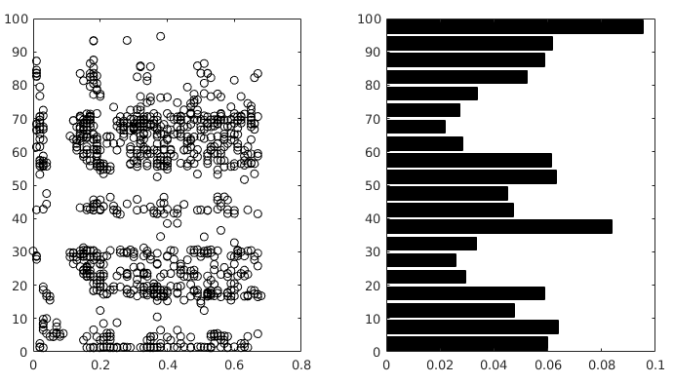
Wave initiation sites with background stimulation
Simulated a single column 100 times with both impulsive and background stimulation
Recorded all wave initiation times and positions for 100 simulations with background stimulation
Created composite histogram of firing density for 100 impulsive simulations
Wave initiation seems to happen consistently around layers 25 and 60
No clear correlation between wave initiation and preferential firing regions
Wave initiation sites,
Background stimulation
Composite firing histogram, impulsive stimulation
Layer (Z position)
Time (seconds)
% of firing events

Slide 7
Notes from last time
Stim at bottom for controlled waves
Global histogram, try several bin sizes, look for regions of high/low activity
If so, look for correlation in wave initiation sites with background stimulus
Then move on to characterization (speed, density) versus (speed constant, connectivity) before micro analysis
Micro analysis:
Connectivity or neuron parameters explain firing sites
“Echo”

